Slide 1
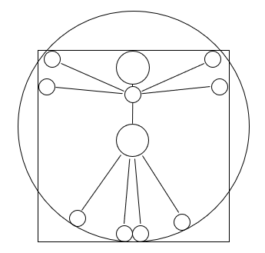

Operator approach to epidemic models
José Alejandro Rojas Venegas
Grupo de Econofísica y Sociofísica
Departamento de Física, Facultad de Ciencias
Universidad Nacional de Colombia

Slide 2
Index
What we want to model -The Markovian Master Equation-.
The formalism -Doi-Peliti field formalism-.
Simple epidemic Hamiltonians.
A warm-up exercise.
Analytic solution and step solution.
SIR model affairs: The probability of no-outbreak.
A communicability-based approximation.
Sampling the master equation with Tau-leaping.
Migration-induced ramifications in simple models.
Variants and migration.
Take-home message.

Slide 3



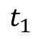
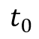
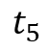
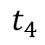
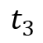
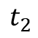
What we want to simulate
Infectious individuals
$$t_{0}$$
$$t_{1}$$
$$t_{2}$$
$$t_{3}$$
$$t_{4}$$
$$t_{5}$$

Slide 4
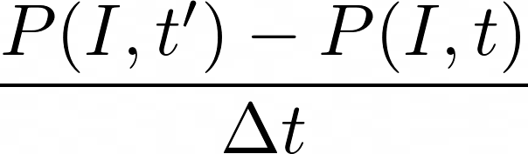
The Markovian master equation
Change in the probability of being in certain state in a time step
Infectious individuals
$$t_{0}$$
$$t_{1}$$
$$t_{2}$$
$$t_{3}$$
$$t_{4}$$
$$t_{5}$$

Slide 5
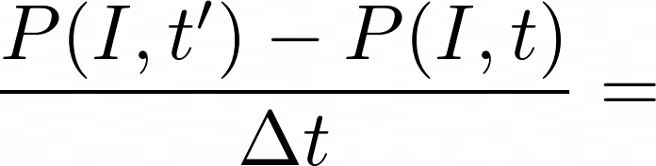
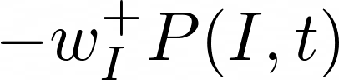
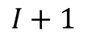
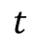
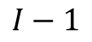

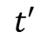
The forward master equation
$$I+1$$
Infectious individuals
$$I$$
$$I−1$$
$$t$$
$$t′$$

Slide 6
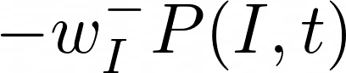
The forward master equation
$$I+1$$
Infectious individuals
$$I$$
$$I−1$$
$$t$$
$$t′$$

Slide 7
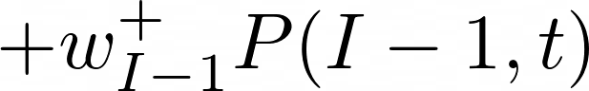
The forward master equation
$$I+1$$
Infectious individuals
$$I$$
$$I−1$$
$$t$$
$$t′$$

Slide 8
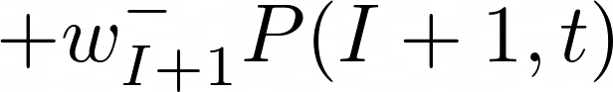
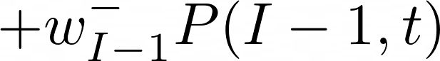
The forward master equation
$$I+1$$
Infectious individuals
$$I$$
$$I−1$$
$$t$$
$$t′$$

Slide 9
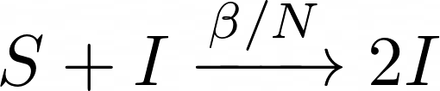
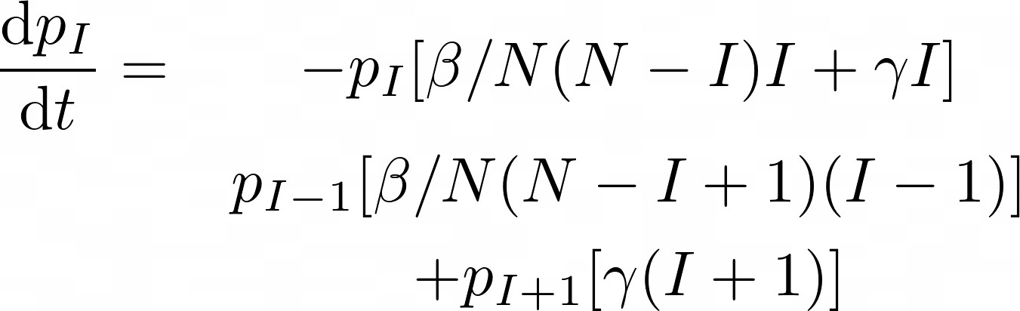
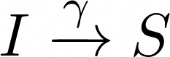
Example: SIS master equation

Slide 10
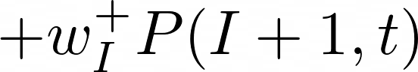
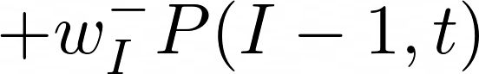
The backward master equation
$$I+1$$
Infectious individuals
$$I$$
$$I−1$$
$$t$$
$$t′$$

Slide 11
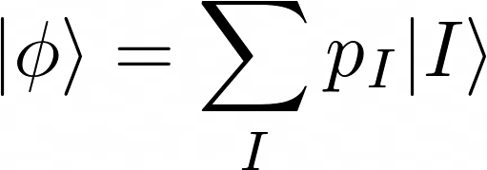
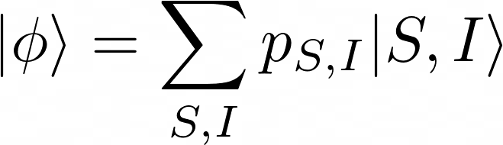
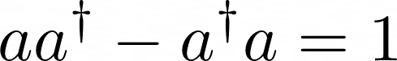
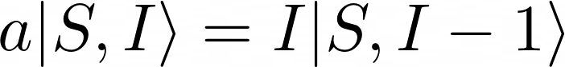
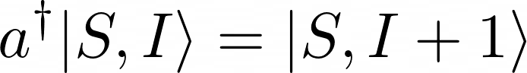
The Doi-Peliti notation
The state represent the probability vector on the probability space
Ladder operators will create the dynamics

Slide 12
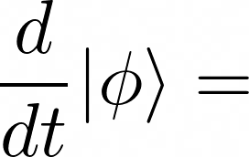
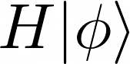
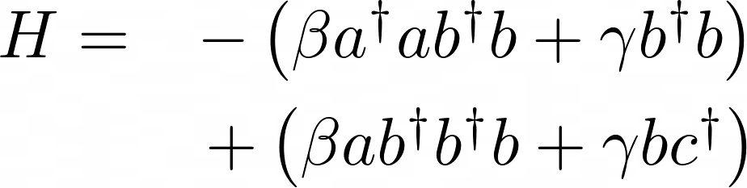
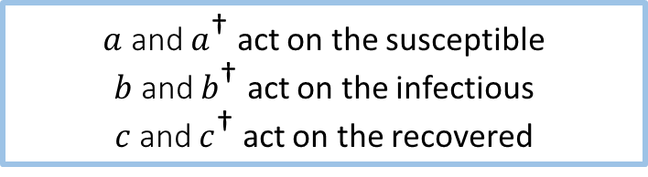
The Doi-Peliti notation
The backward master equation of a system is guided by a Hamiltonian operator
Our interest is the dynamics of the phi state
$a$ and $a^{\text{†}}$ act on the susceptible
$b$ and $b^{\text{†}}$ act on the infectious
$c$ and $c^{\text{†}}$ act on the recovered

Slide 13
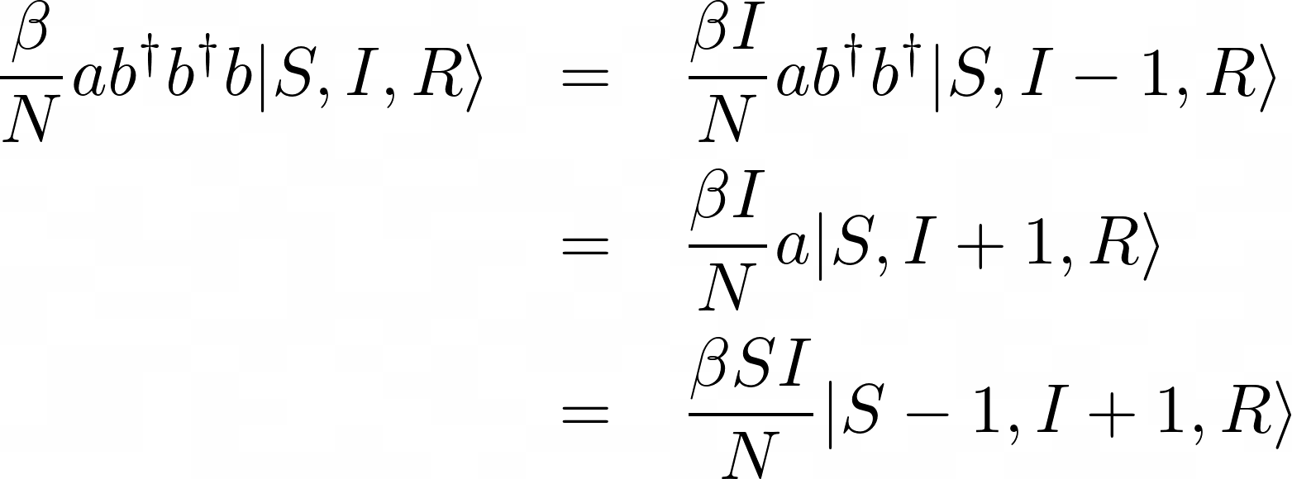
Warm up exercise

Slide 14
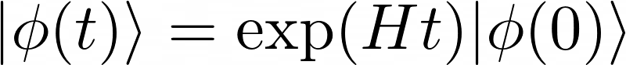
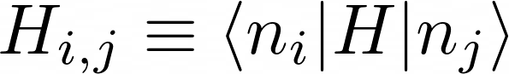
The operator notation
Dynamics is the same as a linear system
To extract the notation from this Hilbert space, it is necessary to compute:

Slide 15
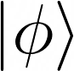
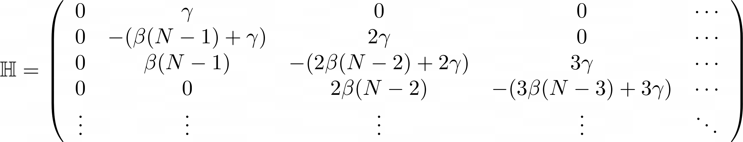
SIS Hamiltonian in matrix form
Phi is analogous to a column vector in the matrix representation

Slide 16
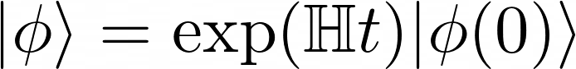
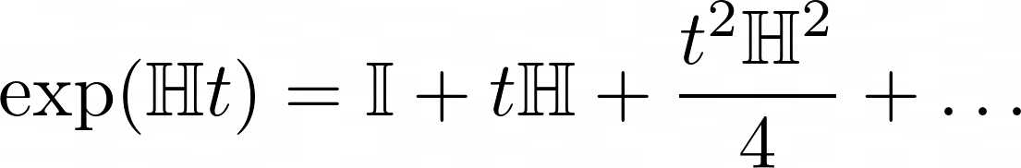
Analytic solution

Slide 17
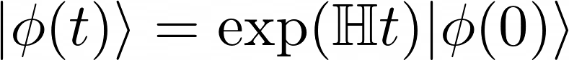
Step solution - Markovianity
As this Master Equation is Markovian:
t=0
t=t_1
t=t_2
t’=t
t’=t+dt
t’=t+dt+dt

Slide 18
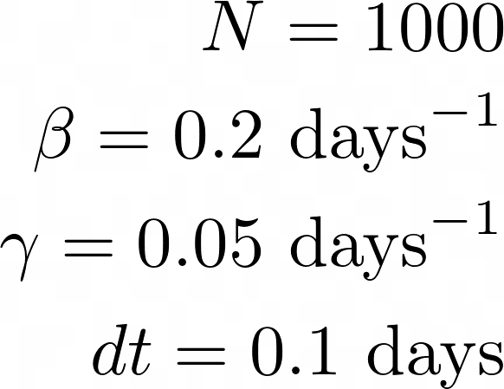
The SIS model solution
The BME was simulated with a 1001x1001 Hamiltonian matrix.
Results are shown as a colormap

Slide 19
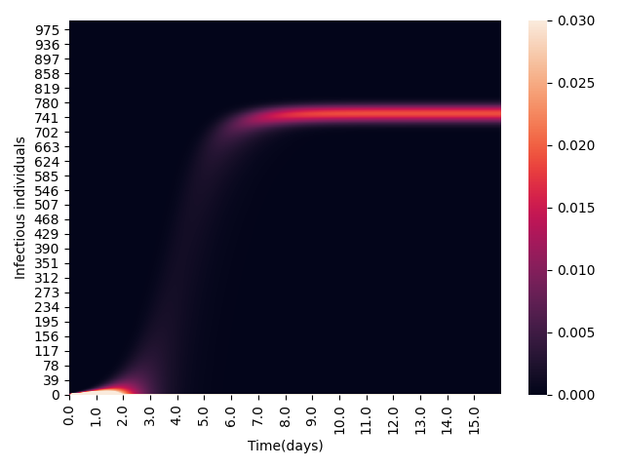
The SIS model solution
Color: Probability of each state
Y-axis : Number of infectious individuals
X-axis: Time

Slide 20
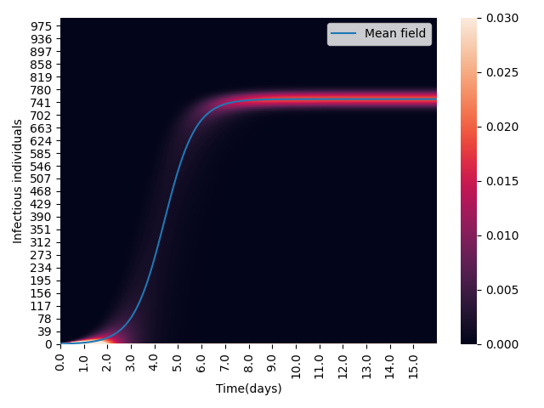
The SIS model solution with Det. Eq.

Slide 21
SIR model affairs
Number of reachable states are N+1 times bigger than in a SIS model
- This representation has (N+1)^2 states e.g. a N=40 SIR model has a 1661x1661 matrix

Slide 22
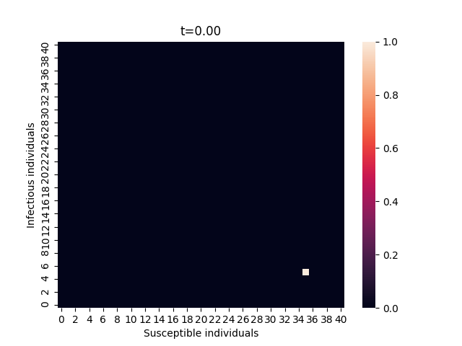
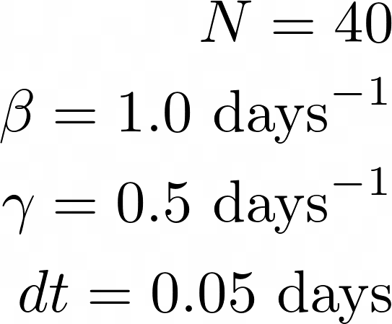
Solution: Phase space

Slide 23
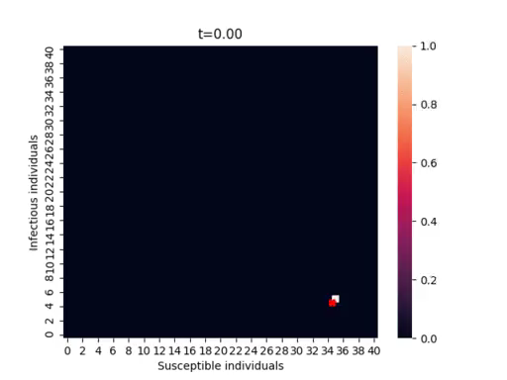
Solution: Phase space

Slide 24
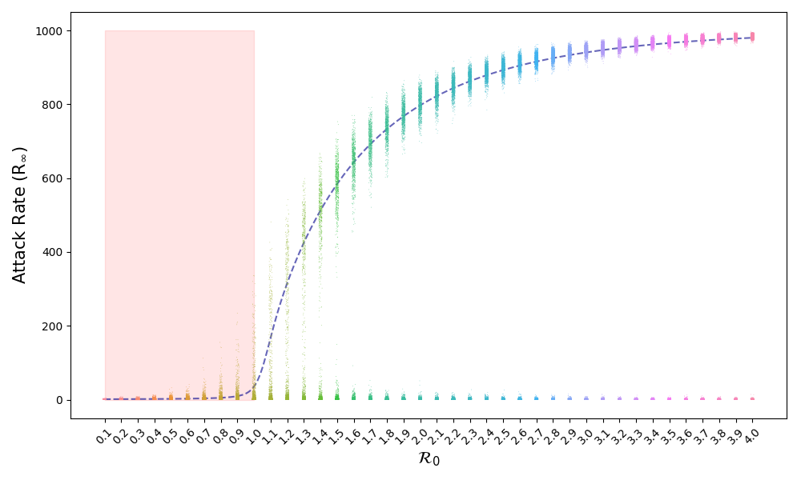
Probability of no-outbreak
Sometimes, if the initial condition is small, there is no outbreak

Slide 25
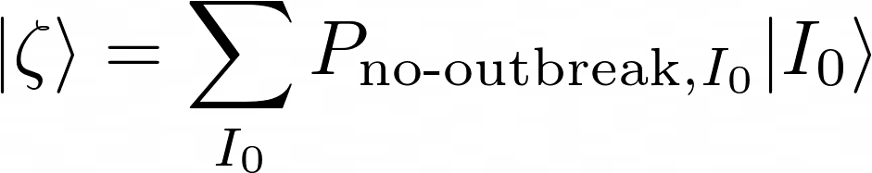
Probability of no-outbreak
Let us define a state (zeta) that includes the probability of no-outbreak for each initial condition ($I_{0}$):
zeta state is related to a stationary state of the system, then it fulfils the same Backward Master Equation

Slide 26
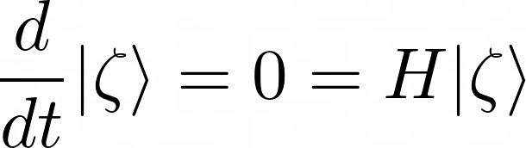
Probability of no-outbreak
Let us define a state (zeta) that includes the probability of no-outbreak for each initial condition ($I_{0}$):
zeta state is related to a stationary state of the system, then it fulfils the same Backward Master Equation

Slide 27
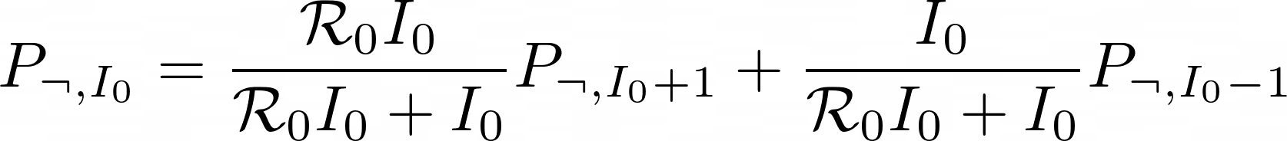
Probability of no-outbreak
Applying H on zeta one gets ($P_{no−outbreak,I_{0}}$ is now called $P_{¬,I_{0}}$ ):
Let’s assume that there is no recovered individuals at t=0 and that $S_{0}≈N$ which is analogous to
$I_{0}≪N$, with this we get

Slide 28




Probability of no-outbreak
With $I_{0}=1$
$P_{¬,0 }=1$, and let’s assume that $P_{¬,2 }=$ ${P_{¬,1 }}^{2}$ as $N→∞$ and lineages from different infectious individuals
are independent. With this:

Slide 29


Probability of no-outbreak
More generally:
Same solution as Whittle (1955) using
probability theory (6 pages of algebra)

Slide 30

Endemic states
Same probability space as SIR

Slide 31


Solutions in phase space

Slide 32

Step back: Analytic solution

Slide 33
Step back: Analytic solution

Slide 34
Step back: Analytic solution

Slide 35
Step back: Analytic solution

Slide 36





Is the dynamics truncatable?
$$≈$$
$$<$$
$$>$$
?

Slide 37
The operator network
S=1000
I=0
R=0
S=999
I=1
R=0
S=998
I=2
R=0
S=997
I=3
R=0
…
S=999
I=0
R=1
S=998
I=1
R=1
S=997
I=2
R=1
…
S=998
I=0
R=2
S=997
I=1
R=2
…
S=997
I=0
R=3
…

Slide 38





The operator network
S=999
I=1
R=0
S=998
I=2
R=0
S=997
I=3
R=0
S=999
I=0
R=1
S=998
I=1
R=1
S=997
I=2
R=1
S=998
I=0
R=2
S=997
I=1
R=2
S=997
I=0
R=3

Slide 39
The communicability of H (or Ht)
Caminos globales de
orden 0
Caminos globales de
orden 2
Caminos globales de
orden 4
Caminos globales de
orden 1
Caminos globales de
orden 3
Caminos globales de
orden 5

Slide 40

The communicability of H Δt
Caminos locales de
orden 0
Caminos locales de
orden 2
Caminos locales de
orden 4
Caminos locales de
orden 1
Caminos locales de
orden 3
Caminos locales de
orden 5
If Δt is sufficiently small, the jumps are local (at order 1 maximum), and the communicability becomes:

Slide 41
The communicability of H Δt
By using the locality of the evolution rules and a network representation, the evolution can be approximated to:

Slide 42


Testing - SIS

Slide 43


Testing - SIR

Slide 44
Scalability of the exp(Qt) algorithm
System | Size of H
SIS N=10 | 11x11
SIR(S) N=10 | 121x121
SIS N=1000 | 1001x1001
SEIR N=10 | 1331x1331
SIR(S) N=40 | 1681x1681
SIR(S) N=100 | 10 201x10 201
SEIR N=40 | 68 921x68 921
Population network SIR with 10 populations with N=10 each | 12 x10^40
Scalability is (N+1)^m
m is the number of compartments (after constraints)
N is the population

Slide 45



Solving scalability: Sampling
Set conditions and parameters
Calculate propensities (i.e. rates) for each reaction
Calculate
Update states as:

Slide 46


Sampling works
50000 samples
Analytic

Slide 47













Simple migration model

Slide 48




Bifurcations

Slide 49




Bifurcations and stability
Asimmetric mobility can break fixed states of well-mixed populations

Slide 50

Bifurcations

Slide 51




Variants and domination
The whole system have a single variant
Some infectious individuals with a different variant appear in Node 2

Slide 52








Variants and domination

Slide 53






Variants and domination
Node 1
Node 1
Node 1
Node 2
Node 2
Node 2
% of variant a
% of variant b

Slide 54


Variants and domination

Slide 55
Take home messages
Operator methods are a powerful theoretical tool for a certain type of epidemic models as they work with the whole probability space.
Analytic solutions of this formalism can be reduced by Markovianity and locality to easier-to-compute equations, but scalability is a major issue.
Tau-leap sampling allows to simulate and approach to more complex models and show interesting behaviors of migration.

